Slide 1
Storage Area Labels
DDC ##xx
Hazard
Label Color Code (ChemAlert Fischer)
Picto-gram
Relevant precautions:
Hazard type and relevant
Pictograms &
Precautions
Label Color Code (ChemAlert Fischer)
UMN Haz. Waste Codes
Notes:
Closed containers

Slide 2
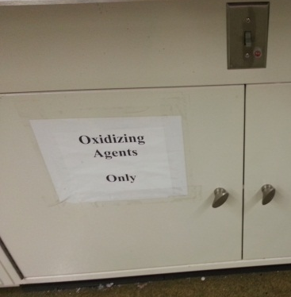
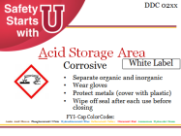
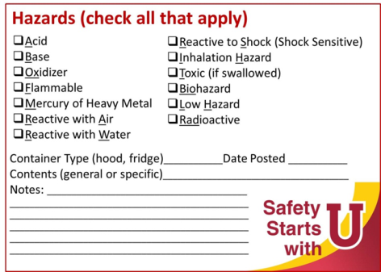
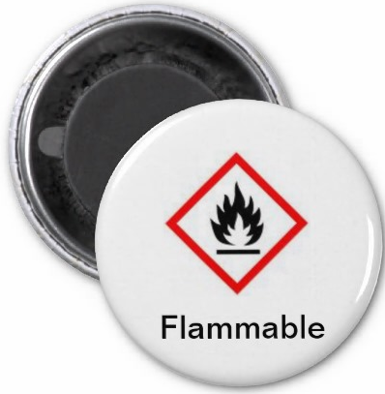
Storage Area Labels
Available formats:
Paper copy (print & tape to area)
Stickers
Magnets
Notes:
Closed containers

Slide 3

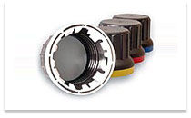
Acid Storage Area
DDC 02xx
Corrosive
White Label
Separate organic and inorganic
Wear gloves
Protect metals (cover with plastic)
Wipe off seal after each use before closing
FYI- Cap Color Codes:
Acetic Acid—Brown PhosphoricAcid—White HydrochloricAcid—Blue SulfuricAcid—Yellow NitricAcid—Red Ammonium Hydroxide—Green

Slide 4
Base Storage Area
DDC 01xx
Corrosive
White Label
Wear gloves
Protect metals (cover with plastic)
Wipe off seal after each use before closing

Slide 5

Oxidizer Storage Area
DDC 16xx
Oxidizing
Yellow Label
keep away from combustible materials

Slide 6

Flammable Storage Area
DDC 08xx
Flammables
Red Label
keep away from oxidizers and ignition sources

Slide 7



Reactive Storage Area
DDC 04xx, 12xx
Reacts with Air, Water or Shock
Keep well sealed. Protect against moisture, & vibration.
Isolate from atmosphere by storing under inert gas (Nitrogen) or liquid (oil)
Yellow Label

Slide 8




Inhalation Hazard Storage Area
DDC ##PH
Toxic if inhaled
Blue Label
Keep well sealed

Slide 9

Toxic (if swallowed) Storage Area
DDC 18xx
Do not swallow, touch or inhale
Blue Label
Wash hands after handling

Slide 10

Low hazard Storage Area
DDC 05xx, 06xx
Keep liquids below eye level
Gray Label
okay to sort alphabetically
Orange Label
Green Label

Slide 11

Radioactive Storage Area
DDC ##RA
Authorized Users Only!
leave shielding in place

Slide 12


Biohazard Storage Area
Do not touch
materials must be inactivated before disposal

Slide 13
Mercury or Heavy Metal Storage Area
Do not ingest
materials must be disposed as hazardous waste

Slide 14


Carcinogen Storage Area
Do not swallow, touch or inhale
use appropriate gloves

Slide 15

Reproductive Toxin Storage Area
Do not swallow, touch or inhale
use appropriate gloves

Slide 16

Nanoparticle Storage Area
Do not swallow, touch or inhale
use appropriate gloves
Keep well sealed

Slide 17
Flammable Acids Storage Area
DDC 08cc, 02LO
Flammable & Corrosive
Keep away from oxidizers and ignition sources
Separate from Flammable Bases

Slide 18
Flammable Bases Storage Area
DDC 08cc, 01LO
Flammable & Corrosive
Keep away from oxidizers and ignition sources
Separate from Flammable Acids

Slide 19

Time Sensitive Materials
Storage Area
DDC ##PF
Peroxide Formers
AVOID metal caps, heat, light
Visually check for crystals
Test every 1, 3, 6 or 12 months
Dispose if > 80 ppm peroxides or > 2 yrs

Slide 20

Temperature Sensitive Materials
Storage Area
Must keep below ____
If not working:
Contact_______________
Keep door closed & or
Relocate materials
Store in secondary containers to segregate hazards & contain spills

Slide 21

Light Sensitive Materials
Storage Area
Keep dark
If light block fails:
Contact_______________
Keep closed & or
Relocate materials
Store in sealed light blocking containment

Slide 22

Wet Storage Area
Keep moist
Do NOT allow to dehydrate
Store in overpack with wet towel to maintain humidity
Notes:
Examples: picric acid

Slide 23
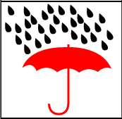
Dry Storage Area
Keep dry
Protect from moisture
Store with desiccant to remove humidity

Slide 24
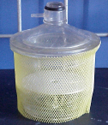
Vacuum Storage Area
Risk of Projectiles
Do NOT heat, cool or attempt to open
Use plastic netting to control glass shards if implosion
Apply grease to seal before closing
Protect from impact

Slide 25
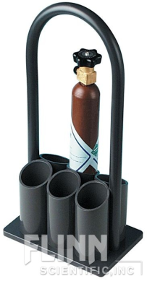

Compressed Gas Storage Area
DDC ##CG
Pressurized materials
Do NOT heat, cool or attempt to open
Secure upright
Protect valve from impact

Slide 26
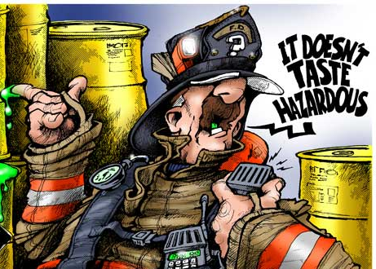
Work Area Labels
Use for:
Include:
Unattended materials
Areas where the hazard is constant
Emergency Contacts
Shut down instructions
Hazards present
Notes:
Purpose is to help emergency responders (non-chemists) know what needs to be done in an emergency

Slide 27

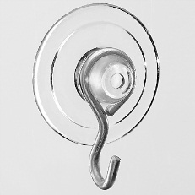
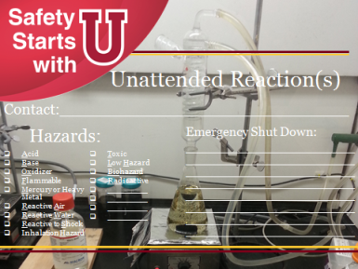
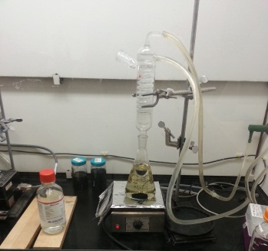

Work Area Labels
Available formats:
Post-it notes
Stickers
Magnets
Window Decals
Suction cups w/Hang tags
Notes:
Closed containers

Slide 28
Hazards:
Unattended Reaction(s)
Contact:___________________________
Emergency Shut Down:
________________________________________________________________________________________________________________________________________________________________________
Acid
Base
Oxidizer
Flammable
Mercury or Heavy Metal
Reactive Air
Reactive Water
Reactive to Shock
Inhalation Hazard
Toxic
Low Hazard
Biohazard
Radioactive
_________
_________
_________
_________

Slide 29
In Case of Emergency
Contact:___________________________
Emergency Shut Down:
________________________________________________________________________________________________________________________________________
Notes:
Unplug____, Turn off _____ valve

Slide 30
Sensitive Materials
Avoid:
Acids
Air
Alcohols
Bases
Cold
Flammables
Halogens
Heat
Mercury or Heavy Metals
Oxidizers
Pressure
Shock
Water

Slide 31
Unattended Hazards:
Acid
Base
Oxidizer
Flammable
Mercury or Heavy Metal
Reactive Air
Reactive Water
Reactive to Shock
Inhalation Hazard
Toxic
Low Hazard
Biohazard
Radioactive
_________
_________
_________
_________

